Slide 1
Honours Macroeconomics
Business Cycle Theory
Topic 3: Introduction to New Keynesian Dynamic Stochastic General Equilibrium Models

Slide 2
Plan
Intro – DSGE models in general
Extend the work of previous lectures
Interpretation and Evaluation of DSGE models

Slide 3
Intro
Ultimate goal: characterize a model that can
Explain how macroeconomic fluctuations are transmitted across various agents/markets
Via endogenous responses to observed economic phenomena
Attach welfare evaluations to these fluctuations
Be used to design/evaluate macroeconomic policies in terms of efficacy and welfare implications
For this to be reliable, the model be able to match the patterns in observed data

Slide 4
For nominal shocks to have real effects
Requires frictions to Price/wage adjustment
To match observed data
These real effects must be persistent
Thus: A useful a model that should be able to give accurate predictions about the speed of adjustments of variables of the model in response to shocks as a function of the parameters of the model
Hence the model must be dynamic
This is the key difference between macro and most of micro
It, unfortunately but predictably, increases the technical difficulty of solving these models in comparison to micro models.

Slide 5
DSGE models
Workhorse of macro, although now in some disrepute
Was unable to predict or immediately explain anything about the global financial crisis
Dynamic
All consumers/firms/authorities are specified as inter-temporally optimizing entities
Stochastic
Inherent feature of real world is its unpredictability, hence the model should mirror this
Implies expectations play central role
General Equilibrium
Systematic closure of the relationships between all players based on behavioural assumptions, market clearing forces, aggregate resources and accounting identities
Price adjustment is the key equilibrating mechanism in general equilibrium models

Slide 6
Today we study the central components of DSGE models that were developed to ask monetary policy questions
Can we build a micro founded model where the model predicts the type of responses to monetary policy interventions that we observe in the data?
Why do we want to do this?
Because in the model, we have a direct measure of welfare, and hence can ask questions about the nature of “optimal” monetary policy
E.g. is inflation targeting a good idea? If so, how should it be implemented (i.e. to what features of the data should monetary policy respond?

Slide 7
Today:
Build baseline parts of model:
Dynamically optimizing households
Yields Dynamic IS curve
Money demand/Asset market
Micro founded by trade-off with interest bearing bond
Imperfectly competitive firms with pricing power as in
Yields firm demand function and optimal price problem
Add:
Price Dynamics
Drop the assumption of real menu costs
Use multiperiod contracts/commitments as a proxy that is more convenient to model
Force price adjustment to be slow/incomplete without having to specify the information problems that lead to this as endogenous consequences of the general equilibrium
Can calibrate this rigidity to attempt to match real world price adjustment patterns

Slide 8
Linear (or Quadratic) approximation
Goal of Macroeconomics:
To understand and predict the dynamic evolution of the economy, in aggregate variables like output, inflation and interest rates (at least) in response to shocks from various sources
Analytical Constraint:
We can usually only solve explicitly for the steady state that emerges in absence of shocks
The equations that describe “optimal reactions” and hence “predicted aggregate dynamics” out of steady state are highly non-linear, with no closed form solution
Compromise Solution:
Use mathematical approximation theories to represent the aggregate dynamics by the closest system of linear (quadratic) equations which we can solve by linear algebra methods
Since we have a steady state to which the economy returns, we will represent our economy in terms of log-deviations from steady state.
These equations then approximate the dynamics of the return to steady state over time after a stochastic disturbance/shock

Slide 9
Final form of the model
We will end up with a linear model that relates three variables in log deviation (% deviation) from steady state:
Our main work today is derive the second equation from the intertemporal problem of price setting in a world where price adjustment in incomplete
This is called the New Keynesian Phillips curve
After that, we will derive the first equation from the full dynamic model of the consumer side, and motivate the third equation

Slide 10
Overview of Model
Households: maximize expected utility
by choices of consumption; money and bond holdings; and labour supply decisions
taking the paths of consumption good prices, wages and interest rates as given
Firms: maximize present value of expected profits
choices of prices that might have to last for several periods
Simple 1:1 production function (no capital)
Continuum of monopolistically competitive firms
Taking as given the behaviour of households, interest rates
Central Bank: sets interest rate path
Key idea: By distorting the relative payoff, policy can change spending behaviour (in terms of timing)
We will assume a fixed rule
More generally, one can solve for the optimal policy

Slide 11
Overview of Model
Households:
Taking as given the paths of prices, wages and interest rates,
households maximize expected utility by choosing, in each period:
How much to consume and how much to save
This yields the consumption Euler equation
How much to work
This yields the labour supply function
How much of savings to place in money vs bonds
This yields the money demand function
How much of total consumption budget to spend on each variety of good
This yields the demand function for each variety

Slide 12
Household Problem
Households:
The basic problem is identical to the RBC model, except
aggregate consumption is now a non-linear aggregation of the different varieties as in the Nominal Rigidities lecture
Add a direct role for money
Ignore expectations/uncertainty for the derivation
Add back at the end
This is not entirely satisfying, but avoids some complications

Slide 13
Aggregate Consumer Problem:
Utility function:
Budget constraint:

Slide 14
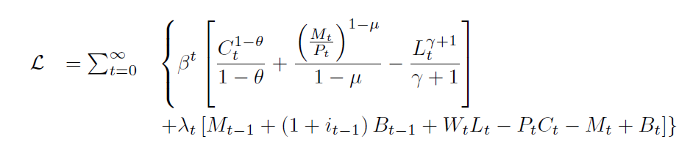
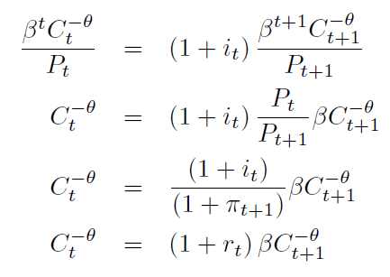
Lagrangian
FOCs with respect to consumption:
FOC with respect to bond holdings:

Slide 15

Lagrangian
FOC with respect to consumption:
FOC with respect to labour supply:

Slide 16
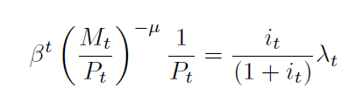
Lagrangian
FOC with respect to consumption:
FOC with respect to bond holdings:
FOC with respect to real money holdings:

Slide 17
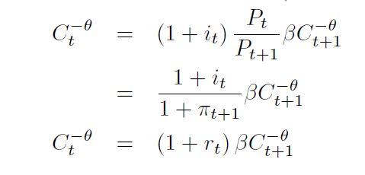
Euler Equation
Households:
Taking as given the paths of wages and interest rates, households maximize expected utility by choosing, in each period:
How much to consume and how much to save
This yields the consumption Euler equation

Slide 18
Final form of the model
We will end up with a linear model that relates three variables in log deviation from steady state:

Slide 19
Equilibrium: Goods Market
In steady state:

Slide 20
Equilibrium: Goods Market
From the Euler Equation:
Subtract the steady
State consumption
from both sides:
Rearrange:

Slide 21

Equilibrium: Goods Market
From above:
In equilibrium:
Now we define* the symbols for “log deviation from steady state”:
Putting everything together:
*somewhat poor notation, slightly different from Romer – the details that motivates this approach are beyond our scope

Slide 22
Equilibrium: Goods Market
If we had started with an uncertain economy this would become:

Slide 23
Final form of the model
We will end up with a linear model that relates three variables in log deviation from steady state:
The first equation is the modern version of the undergraduate IS curve
Note that it is dynamic and stochastic (if there are demand shocks)
Next, we complete the derivations of consumer side, then derive the Phillips Curve (second equation)

Slide 24
Labour Supply and Equilibrium
Households:
Taking as given the paths of wages and interest rates, households maximize expected utility by choosing, in each period:
How much to work
This yields the labour supply function:

Slide 25
Equilibrium: Labour Market
Markets must clear in each period:
Plug into labour supply function:
Thus in log deviation from steady state:

Slide 26
Money Demand
Households:
Taking as given the paths of prices, wages and interest rates,
households maximize expected utility by choosing, in each period:
How much of savings to place in money vs bonds
This yields the money demand function
We will not use this explicitly, although it remains in the background

Slide 27

Microeconomic Problem of Consumer
Households:
Taking as given the paths of prices, wages and interest rates,
households maximize expected utility by choosing, in each period:
How much of total consumption budget to spend on each variety of good
This yields the demand function for each variety
The derivations are what we did last week, except now they make this (static) decision ever period
In equilibrium:

Slide 28
Firms’ Price Setting Problem
First we start general, and then we make stronger assumptions and approximations to help us solve the problem
End Goal: to show that, if prices are sticky, the optimal price a firm sets today is an average of expected future optimal prices
Assuming a very specific structure on how prices are sticky yields the NK Phillips Curve
There will be a lot of rearrangements and replacements in this derivation

Slide 29
Firms’ Price Setting Problem
There will be a lot of rearrangements and replacements in this derivation
It might seem confusing/hard to keep track of
The whole point of these replacements is to get rid of things that are not necessary to keep track of to get to the final result
It is important that I cover all the steps, because to sell a model like this to the academic community, all the steps have to be there. We cannot critically compare “hand-waving” arguments.
Thus: In each step of the derivations, make sure that you understand each concept. Once we assume it away, forget about it and make sure that you understand the stuff we keep
As always: stop me as soon as you feel you are getting lost

Slide 30
Key theoretical modelling device: price stickiness
Menu Cost pricing is an example of state dependent pricing
Adjust prices when the state of the economy changes sufficiently
More difficult to use in GE models
We will consider models of time dependent pricing
Firms “are allowed” to adjust prices only at regular or random intervals
Captures persistence in prices, hence real nominal effects exogenously
Typically calibrated to data to attempt a representative model of nominal shocks with real effects.
Prices are set by staggered multi-period contracts/commitments
Each period, contracts governing a fraction of prices expire and must be renewed
Implies gradual adjustment of the aggregate price level

Slide 31

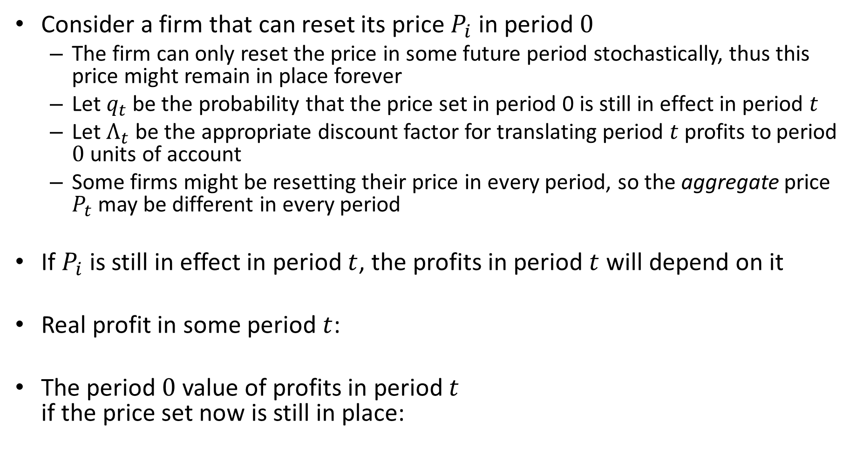
Firms’ Price Setting Problem
Consider a firm that can reset its price $P_{i}$ in period $0$
The firm can only reset the price in some future period stochastically, thus this price might remain in place forever
Let $q_{t}$ be the probability that the price set in period 0 is still in effect in period $t$
Let $Λ_{t}$ be the appropriate discount factor for translating period $t$ profits to period $0$ units of account
Some firms might be resetting their price in every period, so the aggregate price $P_{t}$ may be different in every period
If $P_{i}$ is still in effect in period $t$, the profits in period $t$ will depend on it
Real profit in some period $t$:
The period $0$ value of profits in period $t$ if the price set now is still in place:

Slide 32

Firms’ Price Setting Problem
The period $0$ value of profits in period $t$ if the price set now is still in place:
Thus the problem facing the firm in period 0 is to set the new price $P_{i}$ to solve:

Slide 33

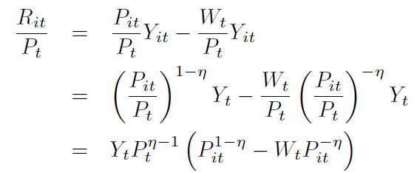

Firms’ Price Setting Problem
The demand function for good $i$:
Real profit in period $t$:

Slide 34
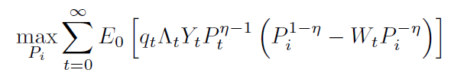
Firms’ Price Setting Problem
Thus the problem becomes:
As a modelling device, it is more convenient/intuitive to express the price setting problem as a function of the desired price in each period if prices were flexible, rather than the wage rate
If the firm could set it’s price every period, we showed last lecture that it is a function of the real wage:
The RHS of the equation does not depend on the firm type, so we can drop the individual index
We can rearrange this to eliminate the wage from the firms problem:

Slide 35
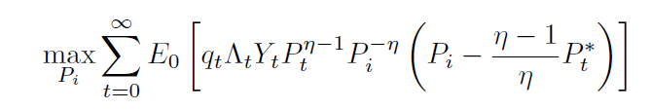
Firms’ Price Setting Problem
Thus the problem becomes:
Taking stock:
We have derived a micro-founded problem for the optimal price a firm should set
It is a function of
The price that is set (potentially for all of the future)
The optimal price that would have been set period by period if it were possible
The currently unspecified probability of being allowed to reset prices
Time varying aggregate equilibrium outcomes not under control of the firm
Discount factor (which is a function of interest rates/consumption choices)
Aggregate Demand
Aggregate Price
Next step: simplification assumptions and approximation to turn into a solvable problem

Slide 36
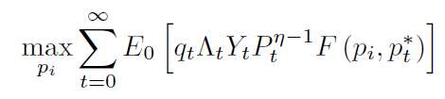
Firms’ Price Setting Problem
The problem is:
Approximation:
Since we will approximate, the exact nature of the non-linearity is not important. All that matters is that there is some known function that relates the ideal price in each period with the current price being set, thus:

Slide 37
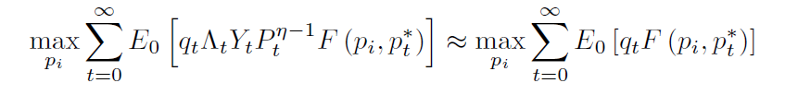
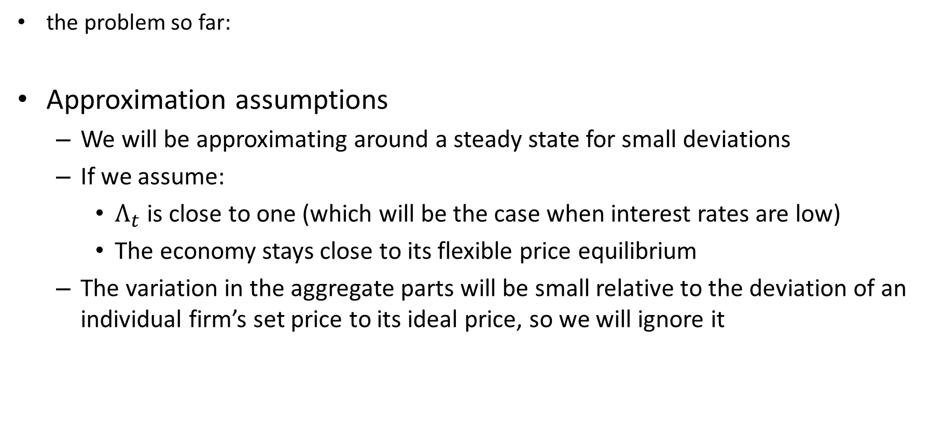
Firms’ Price Setting Problem
the problem so far:
Approximation assumptions
We will be approximating around a steady state for small deviations
If we assume:
$Λ_{t}$ is close to one (which will be the case when interest rates are low)
The economy stays close to its flexible price equilibrium
The variation in the aggregate parts will be small relative to the deviation of an individual firm’s set price to its ideal price, so we will ignore it

Slide 38
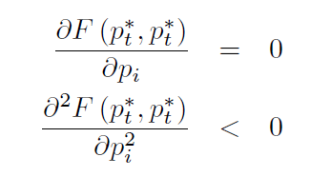


Firms’ Price Setting Problem
$F\left(p_{i},p_{t}^{∗}\right)$ is maximized in each period when prices are flexible, i.e. at $F\left(p_{t}^{∗},p_{t}^{∗}\right)$
Consider a second order approximation around this point:
At the maximum:
So:

Slide 39
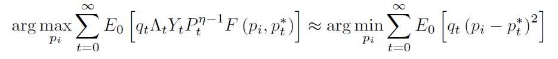
Firms’ Price Setting Problem
The period objective function is
We are not interested in the maximum of this function, but in its maximizer – i.e. the argument that solves the maximization problem: the optimal price
Thus we make a further approximation:

Slide 40





The key idea
We have a function $f$, for which we want to find the maximizer:
$$\max{f(p_{i})}$$
$${f(p}_{i})$$
$$\operatorname{argmax}{f(p_{i})}$$
$$p_{i}$$

Slide 41






The key idea
Which is equivalent to finding the minimizer of the negative of the function ($−f$)
$$\max{f(p_{i})}$$
$${f(p}_{i})$$
$$\operatorname{argmin}\left[−f\left(p_{i}\right)\right]$$
$$p_{i}$$
$${−f(p}_{i})$$
$$\min\left[−\hat{f}\left(p_{i}\right)\right]$$

Slide 42




The key idea
And to finding the minimizer of the quadratic approximation $−\hat{f}$:
$$\max{f(p_{i})}$$
$${f(p}_{i})$$
$$\operatorname{argmin}\left[−\hat{f}\left(p_{i}\right)\right]$$
$$p_{i}$$
$${−\hat{f}(p}_{i})$$
$$\min\left[−f\left(p_{i}\right)\right]=\min\left[−\hat{f}\left(p_{i}\right)\right]$$

Slide 43
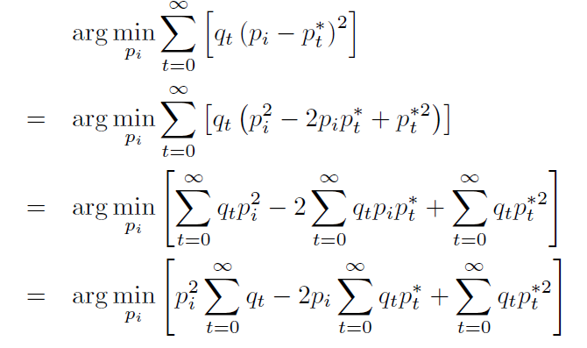
Firms’ Price Setting Problem
Our problem has become (ignoring expectations for exposition):

Slide 44
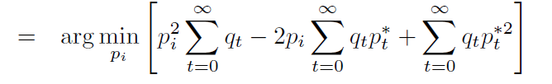
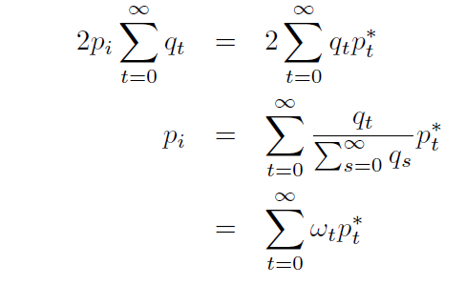
Firms’ Price Setting Problem
Our problem has become (ignoring expectations for exposition):
The first order condition is:

Slide 45
Firms’ Price Setting Problem
Under uncertainty:
Interpretation: the optimal price for a firm to set in period 0 if it might stay in effect indefinitely is the probability weighted average of all expected future optimal prices in the flexible price world.

Slide 46
Firms’ Price Setting Problem
In equilibrium, we can relate the optimal price of a firm to the choices of the consumer, all in log deviations from steady state:
Optimal price as a function of marginal cost:
Optimal labour supply:
A simple monetary equilibrium:

Slide 47
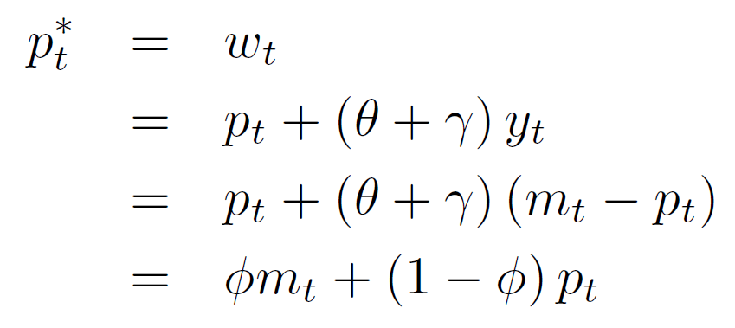

Firms’ Price Setting Problem
Combining:
Where:
Finally, then, we have derived that the optimal price that a firm that gets to reset its price should set is its probability weighted expectation of all future aggregate nominal conditions:
The key point for a macro/monetary economist who wants to fit the data, is that the coefficients of this optimal choice depend on the primitive assumptions about the preferences of the consumer, which, in principle, can be estimated and validated against micro evidence, hence be robust to the Lucas critique.

Slide 48
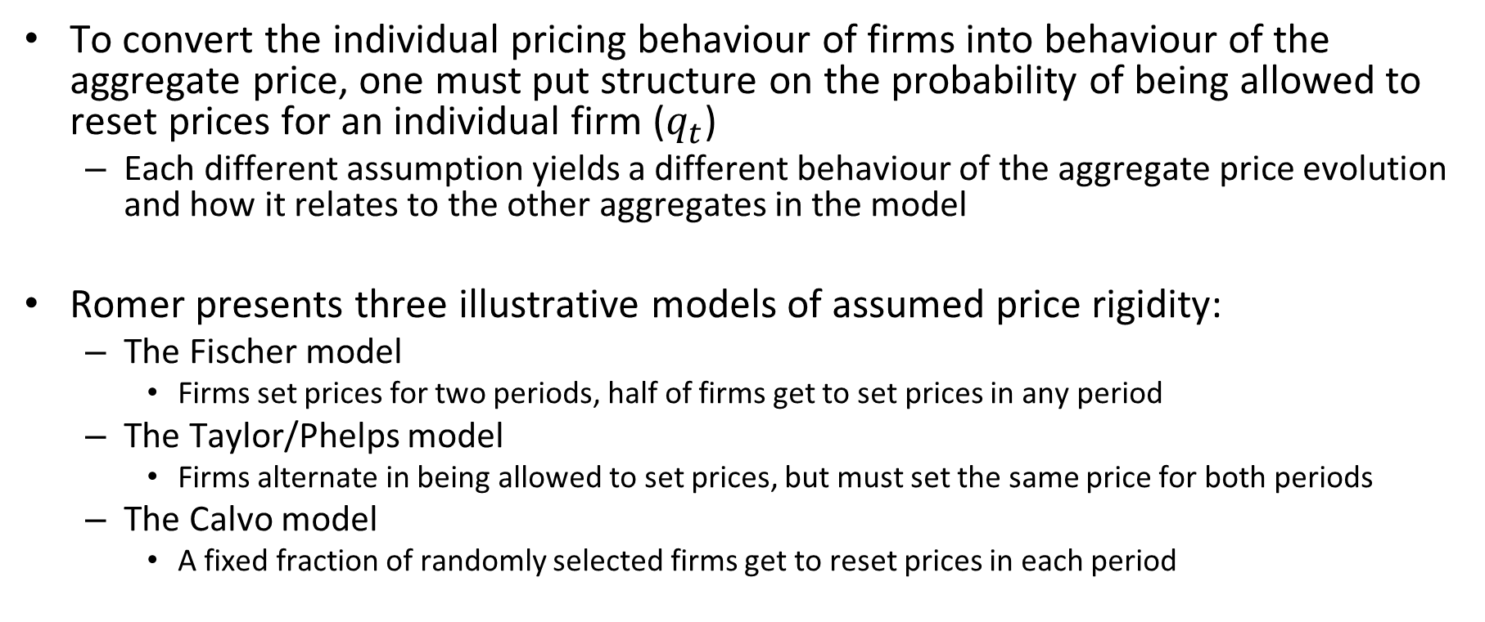
Specific models of staggered price setting
To convert the individual pricing behaviour of firms into behaviour of the aggregate price, one must put structure on the probability of being allowed to reset prices for an individual firm ($q_{t}$)
Each different assumption yields a different behaviour of the aggregate price evolution and how it relates to the other aggregates in the model
Romer presents three illustrative models of assumed price rigidity:
The Fischer model
Firms set prices for two periods, half of firms get to set prices in any period
The Taylor/Phelps model
Firms alternate in being allowed to set prices, but must set the same price for both periods
The Calvo model
A fixed fraction of randomly selected firms get to reset prices in each period

Slide 49
Fischer Model
Working through the model to get at what a “solution” to a DSGE typically looks like
Exercise in working with expectations
Firms alternate periods in which they get to change their prices. (half in each period)
In t, set prices for (t+1) and (t+2)
Goal: find equations for p and y in terms of only m (which is what the central bank controls)

Slide 50
Implications of the Fischer Model
Price setters set prices for future periods
Future shocks to demand cannot shift prices, thus
Unanticipated demand shifts have real effects
Information revealed between t-1 and t-2 have real and pricing effects
When phi is low (real rigidity is high) prices are slow to adjust

Slide 51
Taylor/Phelps Model
Similar to Fischer, but firms must set same price for the two periods
Good exercise in an important solution technique in macro:
The method of undetermined coefficients
We will not work through this
I urge you to do so though, should you wish to carry on with macro

Slide 52

Calvo Model
Extremely influential in the New Keynesian literature
Opportunities for changing prices arrive stochastically
According to a Poisson process
Each period a firm has probability α of getting to change its price
This means by the LLN that α of firms get to reset their prices every period
This gives a simple, deterministic expression for the probability that a price will remain in effect for t periods:
It also makes it simple to allow for a more realistic discount rate
This is a very flexible as one can attain any degree of price rigidity by varying alpha
Or by estimating it

Slide 53
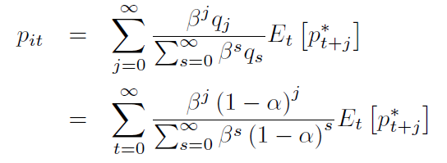

Calvo Model
In this model, the optimal price in a specific period for a specific period becomes
Since all firms that are allowed to reset price in a period faces the same problem, they will all set the same price (denoted by $x_{t}$ in the text book since there are a lot of p’s floating around), this implies that the aggregate price in any period is give by:

Slide 54
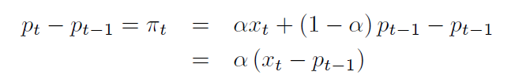
Calvo Model
We can convert the aggregate price relationship to an equivalent form in terms of inflation rates:
This means:

Slide 55
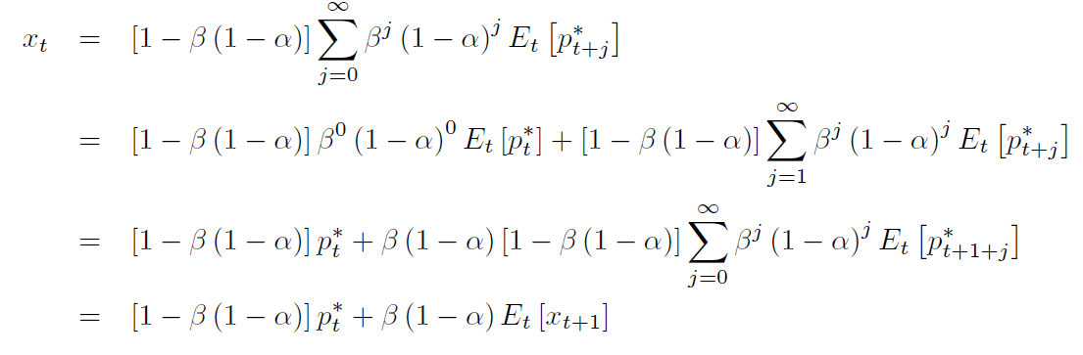
Calvo Model
Let’s unpack the optimal price of firms that get to reset price:
Next step: rework so that we can state in terms of inflation

Slide 56

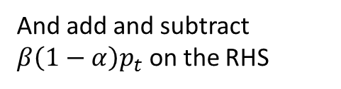
Calvo Model
We have inflation term for all terms with x and p in them, but what about ?
This is the difference between what the aggregate price would have been if prices were flexible and the actual aggregate price under sticky prices
I.e. the measure of the economy’s departure from the efficient flexible price equilibrium
From above:
And add and subtract $β\left(1−α\right)p_{t}$ on the RHS

Slide 57

Calvo Model
Using all our substitutions and rearranging:
Defining yields the New Keynesian Phillips Curve:

Slide 58
Final form of the model
We will end up with a linear model that relates three variables in log deviation from steady state:
The third equation we do not derive, but motivate as a policy reaction function for the monetary authority

Slide 59
The monetary authority
Central Bank
Key idea: By distorting the relative payoff of money vs bonds, policy can change spending behaviour
Older theories: Central banks choose money supply to induce an equilibrium interest rate
Current reality: Commercial banks can create money through lending, thus central banks do not control the money supply.
Think in terms of M1 (Cash and deposits) vs M3 (includes longer term deposits, which in the banking world is equivalent to the loans they provide)
Look up “Markus Economicus” on YouTube for an interesting new theory of money: the i-theory of money (i for intermediation)

Slide 60
The monetary authority
Central Bank
In models: Central banks are assumed to directly control the interest rate, with exactly the same effect as the old idea of money supply control
In practice: the methods by which central banks attempt to influence the interest rate varies by country
South African Reserve Bank: Still by intervening on the overnight market in terms of quantities (ask Dawie van Lill)
European Central Bank: Corridor system – maintains an indefinite deposit facility and lending facility with fixed rates for commercial banks to deposit/lend short term liquidity

Slide 61
The monetary authority
Central Bank
In our model, the central bank directly controls the interest rate
It uses a monetary policy rule
Often referred to as a “Taylor rule”
Where is the expected output gap since we are in log deviation from steady state form
In these models, we have an explicit welfare metric (utility) so one can solve for “optimal monetary policy”
See Michael Woodford (2003) “Interest and Prices Foundations of a Theory of Monetary Policy” Princeton University Press
For a measly $115

Slide 62
DSGE models
Now we have a typical DSGE model in linear approximation:
This is a system of simultaneous difference equations in the three endogenous aggregate variables
This system determines the transmission and persistence of shocks to any one of the equations
All the coefficients are related to fundamental microeconomic parameters of the model, or policy choices, so should be robust to the Lucas Critique in principle

Slide 63
Interpreting the theory
How do we illustrate the implications of this three equation model?
Impulse response functions:
trace the dynamic adjustment path of each endogenous variable after an exogenous shock to the system, as implied by the model
Not trivial to do (due to the expectations terms), but there are standard techniques to solve systems of stochastic difference equations
In short: iterated substitution for the expectations combined with terminal conditions (similar
Requires calibration
From Woodford (2003):

Slide 64
Evaluating the theory
For us to judge whether the theory is sufficient guide to monetary policy, it must be able to yield results that match observed data
But what data in what form?
Keep focusing on the fact that the dynamic paths are of major interest.
How do we use data to know what the actual dynamic paths look like?
A standard empirical tool here is a Vector Auto Regression (VAR)

Slide 65
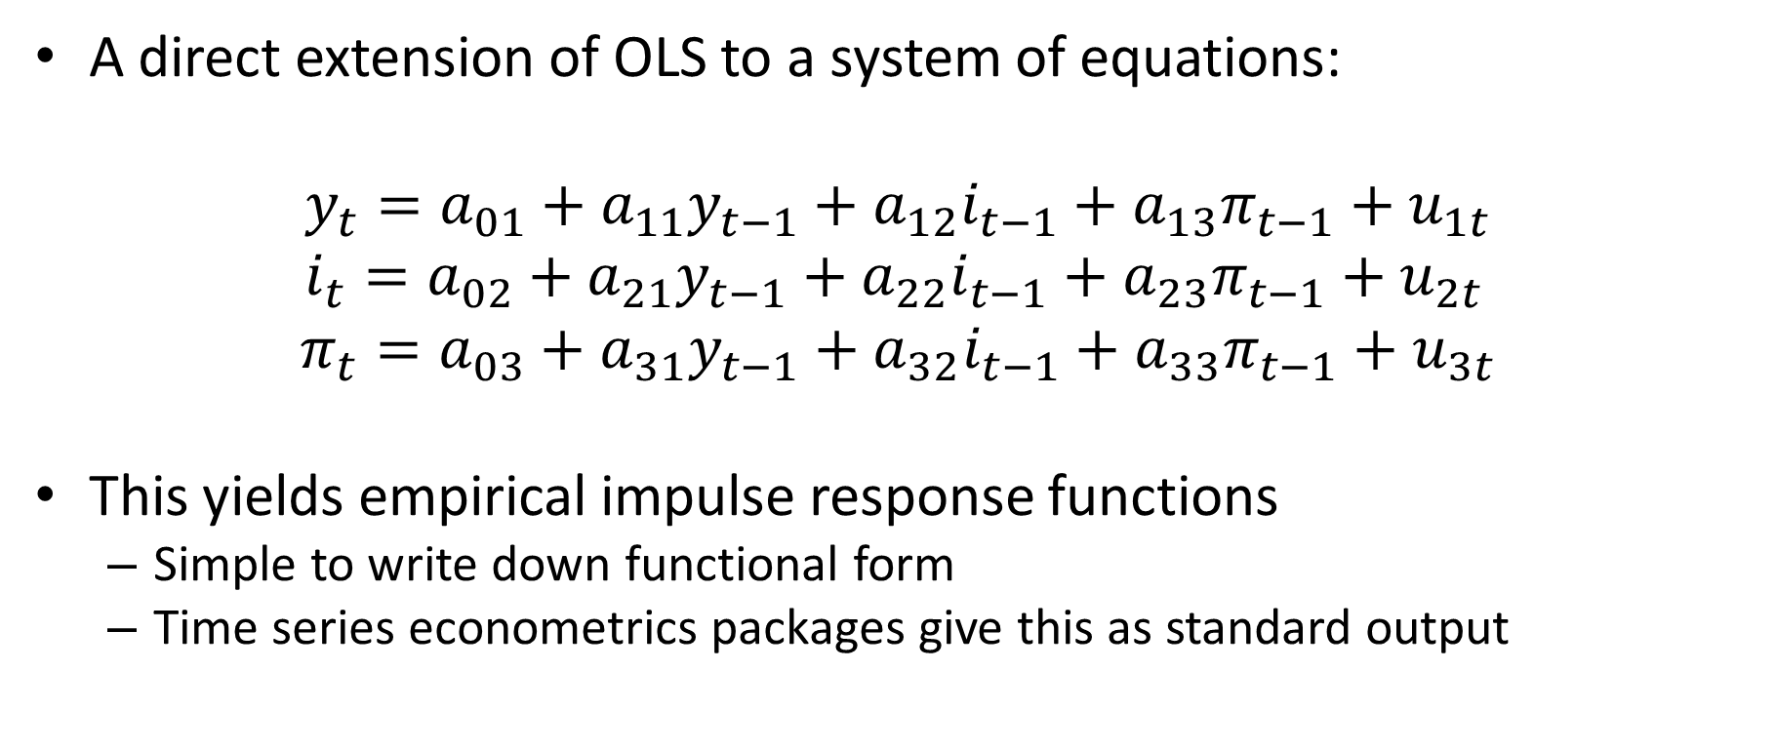
Vector Auto Regressions
A direct extension of OLS to a system of equations:
$$y_{t}=a_{01}+a_{11}y_{t−1}+a_{12}i_{t−1}+a_{13}π_{t−1}+u_{1t} \\ i_{t}=a_{02}+a_{21}y_{t−1}+a_{22}i_{t−1}+a_{23}π_{t−1}+u_{2t}$$
$$π_{t}=a_{03}+a_{31}y_{t−1}+a_{32}i_{t−1}+a_{33}π_{t−1}+u_{3t}$$
This yields empirical impulse response functions
Simple to write down functional form
Time series econometrics packages give this as standard output

Slide 66
A typical estimated IRF:
from Woodford (2003)

Slide 67
Structural estimation
Estimate theoretical model directly
For more complicated models, this requires advanced non-linear estimation techniques, that are not very well behaved.

Slide 68
New Keynesian Philips Curve
The New Keynesian Philips curve we derived thus give the micro foundations of a rational expectations based relationship between output and inflation under staggered price setting when the agents know the model as well as the modeller
It unfortunately does not fit the data well in this simple form

Slide 69
Problems with the simple NKPC
Does not match Macroeconomic behaviour of inflation
The model predicts price persistence, but not inflation persistence
Predicts a boom if inflation is expected to fall some time in the future due to contractionary monetary policy
Does not match Microeconomic evidence on the frequency of price changes
Nakamura and Steinsson (2008) analyzed the raw data on which the US CPI figures are based
The median period between price changes is 4 months
The estimated NKPC predicts 3-4 quarters
The problem is, as mentioned last week, that there is vast heterogeneity in price change frequency

Slide 70
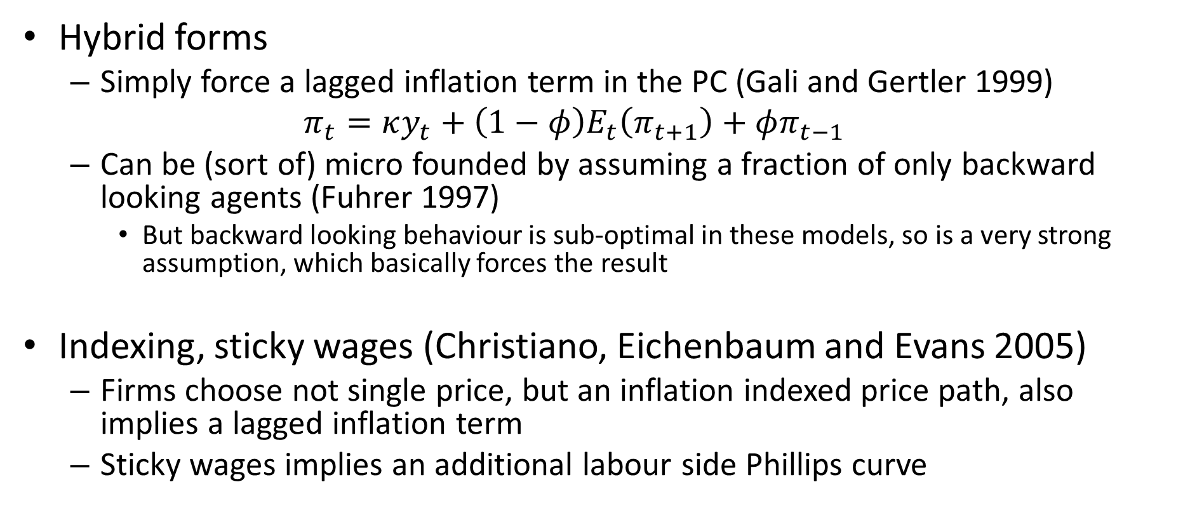
Alternatives to the NKPC
Hybrid forms
Simply force a lagged inflation term in the PC (Gali and Gertler 1999)
$$π_{t}=κy_{t}+\left(1−φ\right)E_{t}\left(π_{t+1}\right)+φπ_{t−1}$$
Can be (sort of) micro founded by assuming a fraction of only backward looking agents (Fuhrer 1997)
But backward looking behaviour is sub-optimal in these models, so is a very strong assumption, which basically forces the result
Indexing, sticky wages (Christiano, Eichenbaum and Evans 2005)
Firms choose not single price, but an inflation indexed price path, also implies a lagged inflation term
Sticky wages implies an additional labour side Phillips curve

Slide 71
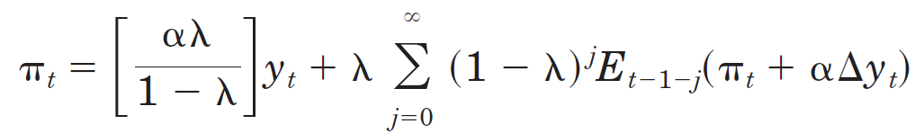
Alternatives to the NKPC
Sticky Information Philips Curve
Rather than assume firms cannot adjust their prices, assume they infrequently update their information sets (Mankiw and Reis 2002)
Because gaining information is costly, which is more defensible than menu costs
There is nominal rigidity not because there are “old prices” in the economy, but because that new price changes are based on “old information”.
This model predicts inflation inertia and no boom for announced disinflation

Slide 72
South Africa?
Burger and Du Plessis (2013) estimate several versions of the NKPC for South Africa
Representative finding: prices fixed for around 4.2 quarters
Reid and du Rand (2015) estimate a Sticky Information PC for South Africa:
Representative finding: information fixed for around 1.3 quarters

Slide 73
Conclusion
These models provide a valuable micro founded way of studying business cycle dynamics
As descriptions of the past, they can be made to fit aggregate data quite well
This is useful for considering what type of policy is optimal
But they are somewhat at odds with micro evidence
Modern models (which Kehoe et al. 2018 call third generation models allow for heterogeneous agents and firms
These models can only be solved by numerical methods

Slide 74
Conclusion
As tools for forecasting, they don’t fare well at all
Good forecasting is necessary for any particular application of a policy type (i.e. given that inflation targeting is optimal in some sense, what is the best way to implement it practice?)
As tools for studying financial crises, even theoretically, they are limited by the nature of the assumptions of representative agents, and the solution concept:
There are few truly dynamic general equilibrium models that can allow for some banks to go bankrupt when others do not
Closest is Gertler and Kiyotaki (2015) AER

